Slide 1
CAR ACCIDENT SEVERITY ANALYSIS Seattle, Washington (Applied Data Science Capstone)
Submitted by : K.S.L Pavan Kumar
Linkedin : https://www.linkedin.com/in/pavankodurupk/
Github : https://github.com/pavankoduru

Slide 2
Table of Contents
1. Introduction
2. Understanding Data
3. Methodology
4. Results
5. Discussion
6. Conclusion

Slide 3
Introduction
Seattle, also known as the Emerald city, is Washington State’s largest city
Vehicles in Seattle in the year 2016 hit a new high of nearly 444,000 vehicles
Worldwide, approximately 1.35 million people die in road crashes each year
Employing methods that alert drivers, health system, and police to remind them to be more careful in critical situations.
Weather, visibility, or road conditions are the major uncontrollable factors
The target audience or stakeholders of the project is local Seattle government, police, rescue groups, and car insurance institutes

Slide 4
Understanding Data
Data was collected by the Seattle Police Department and Accident Traffic Records Department from 2004 to present
Consists of 37 independent variables and 194,673 rows
SEVERITYCODE”, contains numbers that correspond to different levels of severity caused by an accident from 0 to 4
0: Little to no Probability (Clear Conditions)
1: Very Low Probability — Chance or Property Damage
2: Low Probability — Chance of Injury
3: Mild Probability — Chance of Serious Injury
4: High Probability — Chance of Fatality

Slide 5
Feature Selection
Feature Variables | Description
WEATHER | Weather condition during time of collision (Overcast/Rain/Clear)
ROADCOND | Road condition during the collision (Wet/Dry..)
LIGHTCOND | Light conditions during the collision (Lights On/Dark with light on)
SEVERITYCODE | Accident severity condition (0,1,2,3,4)

Slide 6
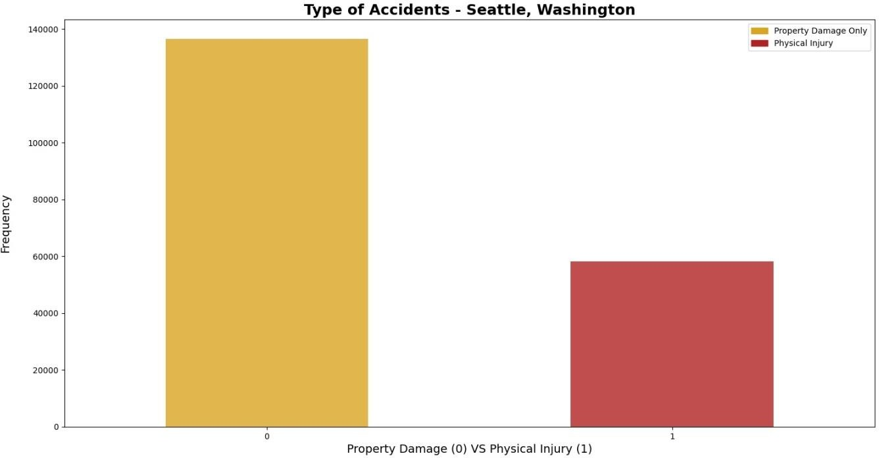
Methodology
Exploratory Data Analysis
Distribution of the target variables between Physical Injury and Property Damage only
Unbalanced dataset, nearly 1:2 as compared to Physical injury
Resampling from library resample used to downsample the dataset

Slide 7
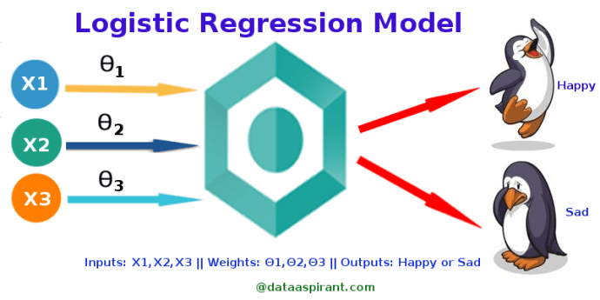
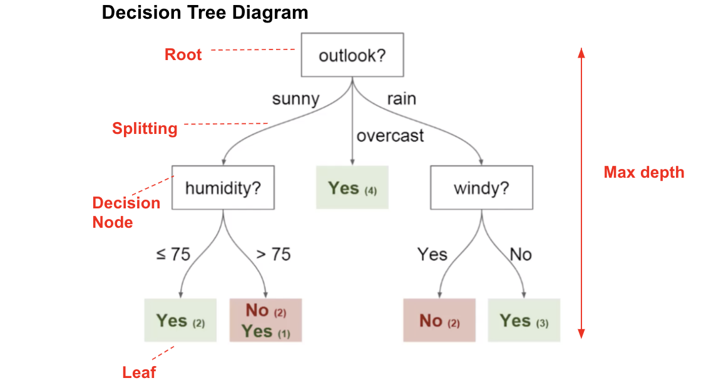
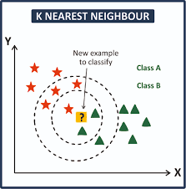
Model Selection
Logistic Regression
Decision Tree Analysis
k-Nearest Neighbor.

Slide 8
Results

Slide 9
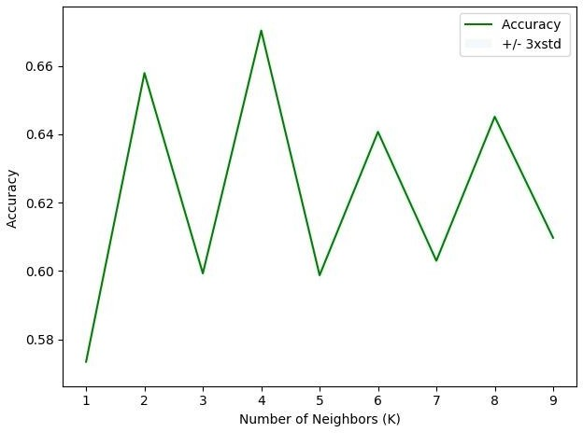
KNN
k-Nearest Neighbor classifier was used from the scikit-learn library
Best K value is 4
Accuracy scores
Algorithm | Jaccard | F1-score | LogLoss
KNN | 0.54 | 0.54 | NA

Slide 10
Decision Tree Model
Decision Tree Classifier was used from the scikit-learn library
Criterion chosen for the classifier was ‘gini’
Accuracy scores
Algorithm | Jaccard | F1-score | LogLoss
DTM | 0.56 | 0.53 | NA

Slide 11
Logistic regression
Logistic Regression was used from the scikit-learn library
C used for regularization strength was ‘0.01
solver used was ‘liblinear’
Accuracy scores
Algorithm | Jaccard | F1-score | LogLoss
LR | 0.55 | 0.52 | 0.67

Slide 12
Discussions
Algorithm | Jaccard | F1-score | LogLoss
KNN | 0.54 | 0.54 | NA
Decision Tree | 0.56 | 0.53 | NA
LogisticRegression | 0.55 | 0.52 | 0.67

Slide 13
F1-score
F1-score is a measure of accuracy of the model, which is the harmonic mean of the model’s precision and recall
k-Nearest Neighbor has the highest f1-score at 0.54
Logistic Regression’s f1-score is the lowest of the three at 0.52

Slide 14
Jaccard coefficient
It’s a measure of similarity for the two sets of data, with a range from 0% to 100%
Decision Tree model has the highest f1-score at 0.56
Neighbor’s f1-score is the lowest of the three at 0.54

Slide 15
Conclusion
F1-score is highest for k-Nearest Neighbor at 0.54
Decision Tree Model gives the best jaccard coefficient among other two models at 0.56
Both the models can be used side by side for the best performance.
[contd]

Slide 16
Models could have performed better if a few more things were present and possible.
A balanced dataset for the target variable
More instances recorded of all the accidents taken place in Seattle, Washington
Less missing values within the dataset for variables such as Speeding and Under the influence
More factors, such as precautionary measures taken when driving, etc.

Slide 17
Thank You

